Slide 1
Lecture 01
Introduction to Machine learning Kirill Svyatov
Ulyanovsk State Technical University k.svyatov@ulstu.ru

Slide 2
Agenda
Brief history of technological revolutions Future technologies
Definitions
Formulation of the problem Definitions
ML applications Methods of ML

Slide 3
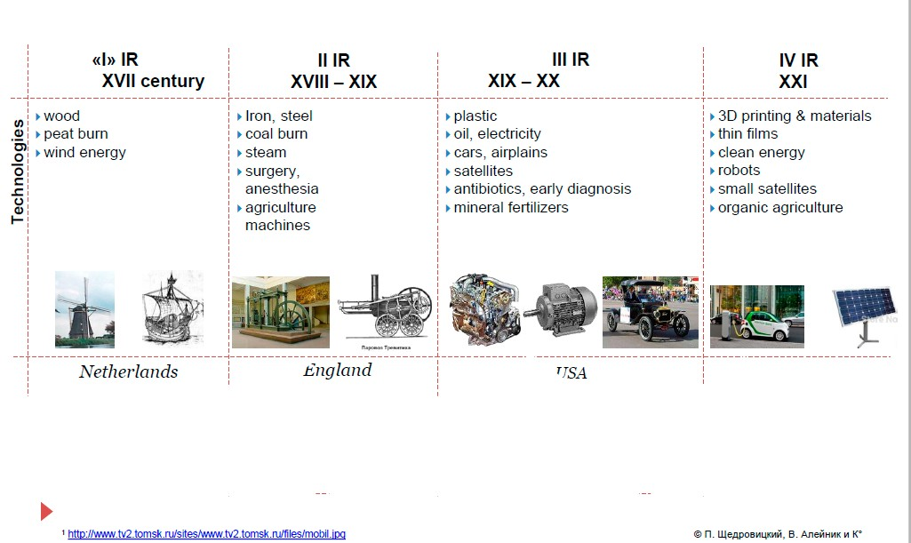
Industrial revolutions

Slide 4
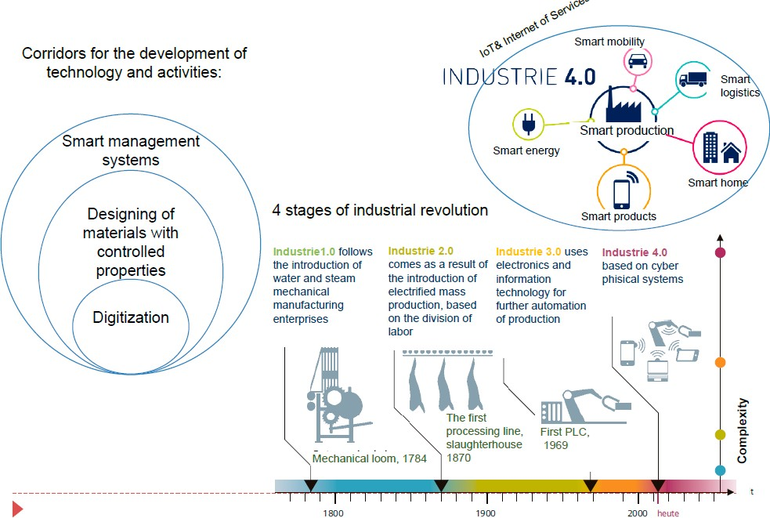
Industry 4.0

Slide 5
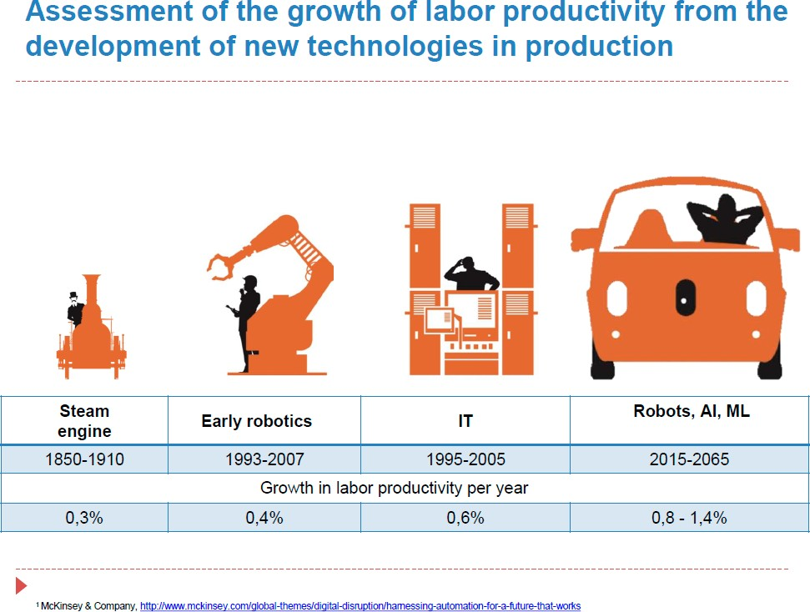
Labor productivity

Slide 6
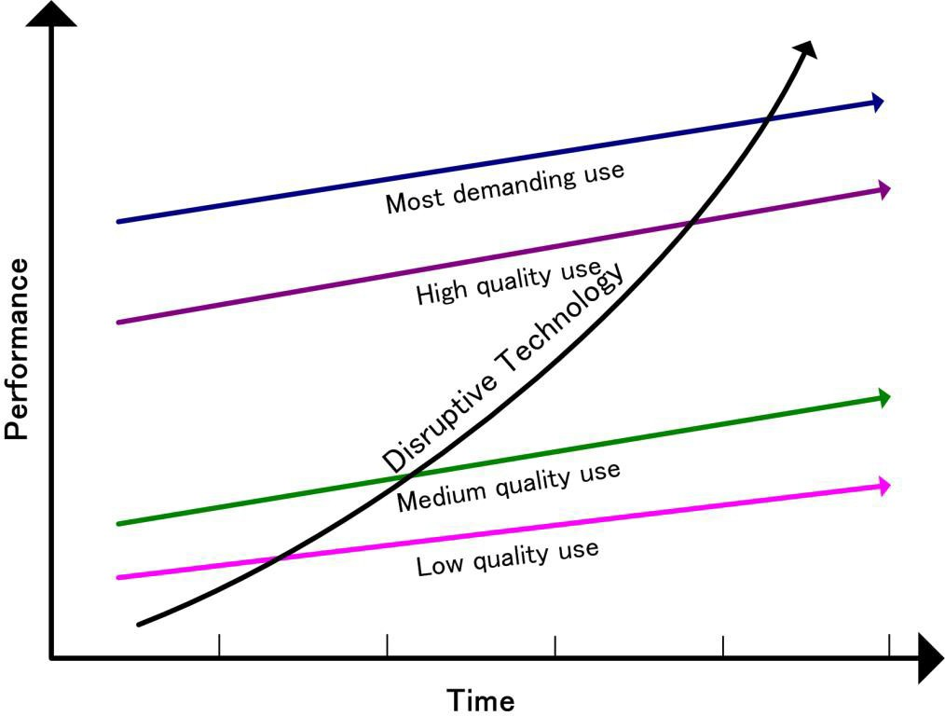
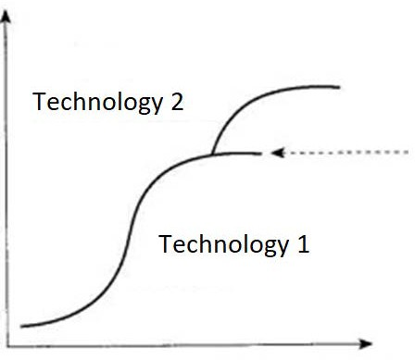
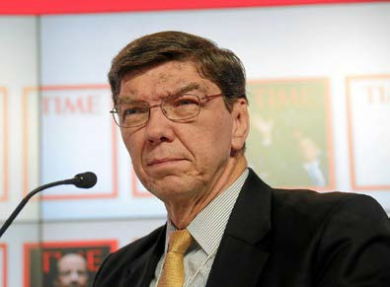
Disruptive technologies
Clayton Cristensen

Slide 7
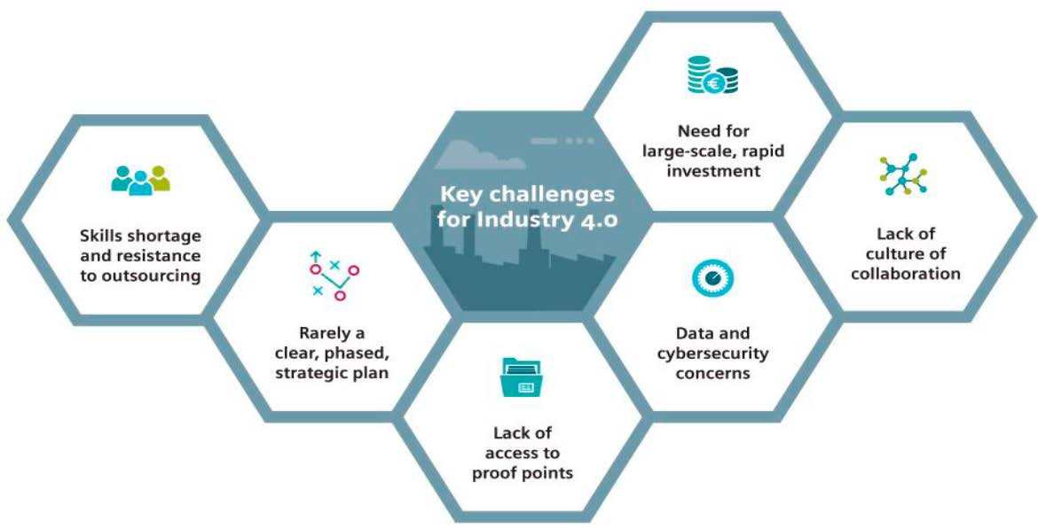
Problems of transformation

Slide 8
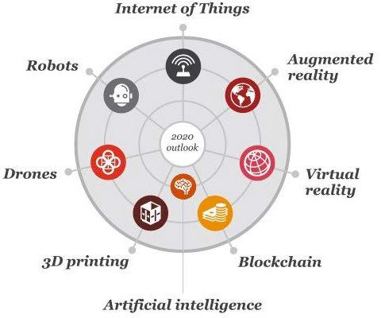
The essential 8 technologies
https://pwc.blogs.com/ceoinsights/2016/08/a-guide-to-the-essential-eight-emerging-technologies.html

Slide 9
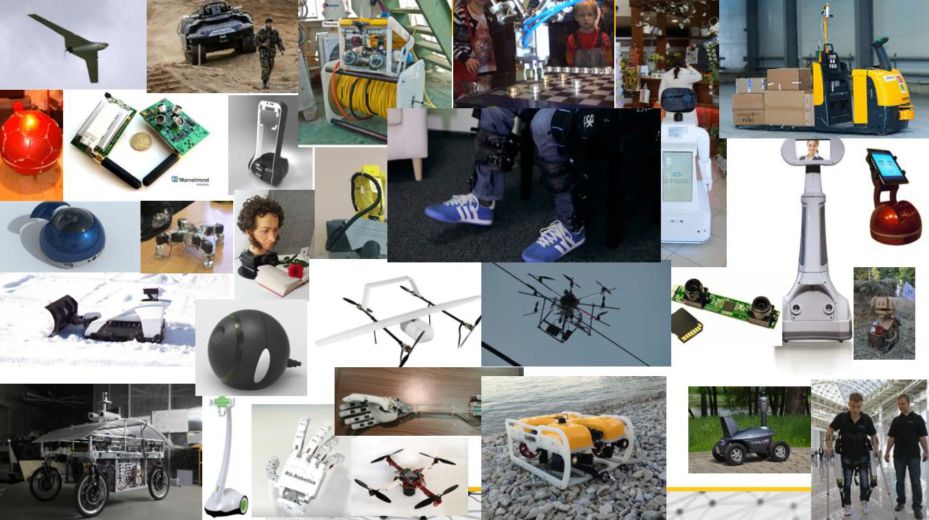

Slide 10
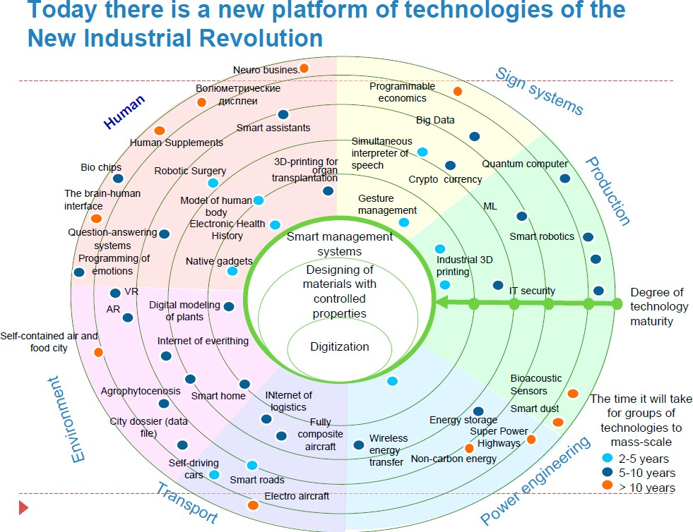
Modern technologies

Slide 11
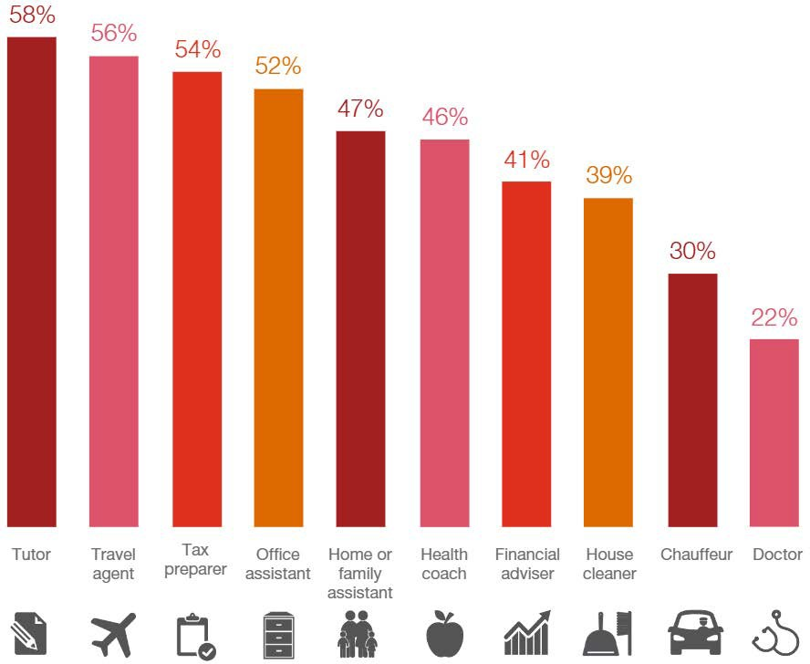
"In the next five years, I can see AI replacing humans as a..."
http://pwcartificialintelligence.com/

Slide 12
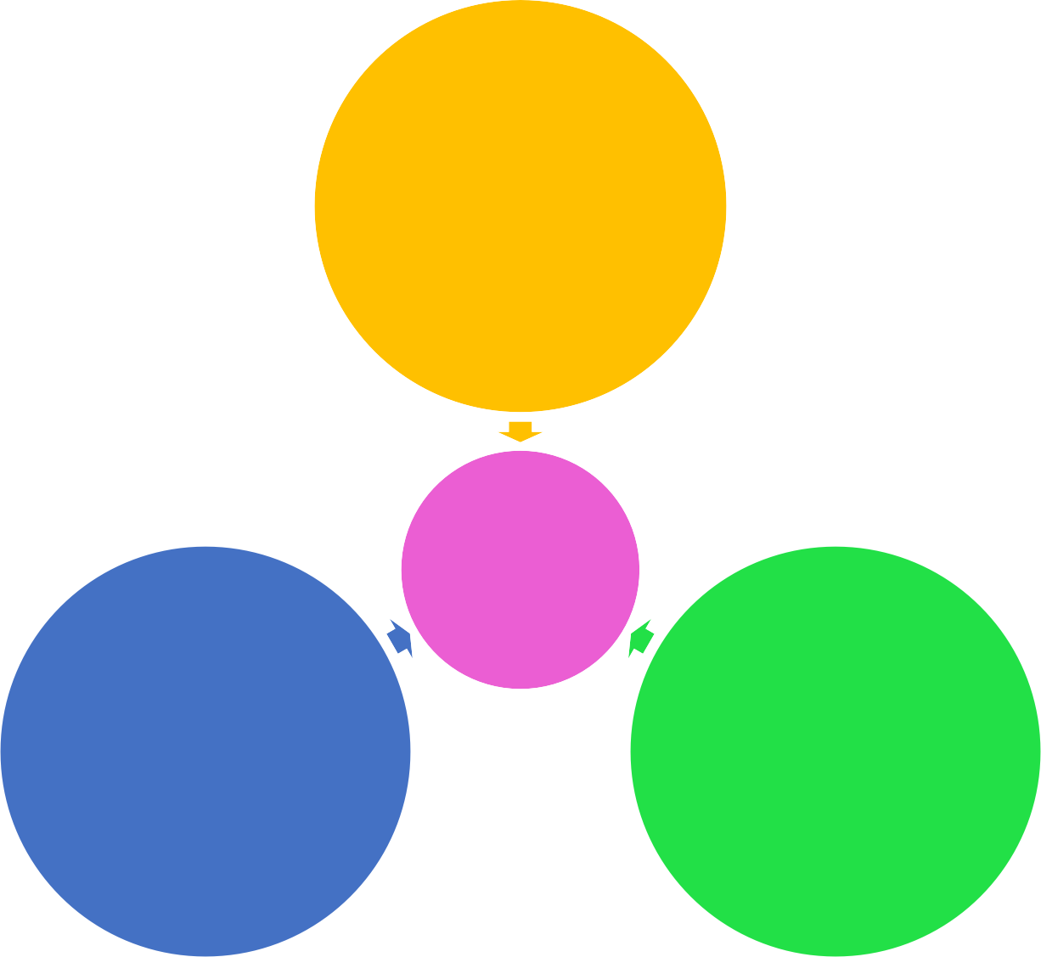
AI winter & spring
1940—1960: first neural networks
New models of ML (Deep learning)
1970—1990: «winter of AI»
1980—2000: algorythms for the second AI spring
2 spring of AI
2010+ — spectacular examples of AI
Big data (Internet & automation)
Performance growth (Moor’s law, specialized processors)
2016+ — investment and media boom

Slide 13
ML definition
Machine Learning:
Machine learning is a topic of an artificial intelligence, a mathematical discipline that uses mathematical statistics, numerical optimization methods, probability theory, discrete analysis, to extract knowledge from data.
Field of study that gives computers the ability to learn without being explicitly programmed. (Arthur Samuel, 1959)

Slide 14
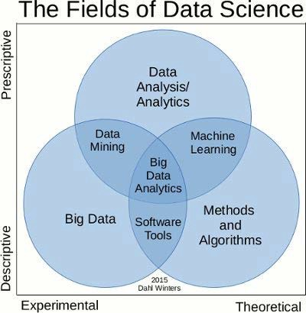

Slide 15
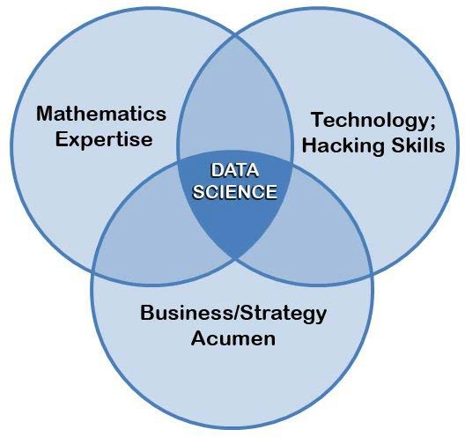

Slide 16
Data mining key features
Data can be inaccurate, incomplete, heterogeneous, indirect, and at the same time have huge volumes;
Data analysis algorithms themselves may have the ability to learn from precedents;
Processes of raw data processing into information require non- trivial automation.

Slide 17
Data mining key features
Over the past decades, significant efforts in the field of Data Mining have focused on the creation of specialized algorithms capable of performing the same tasks during linear or even logarithmic time without significant loss of accuracy.

Slide 18
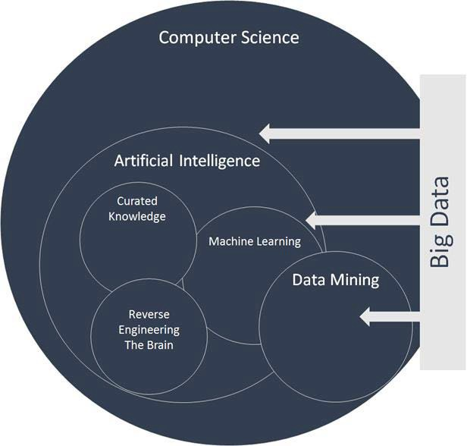
Data mining key features

Slide 19
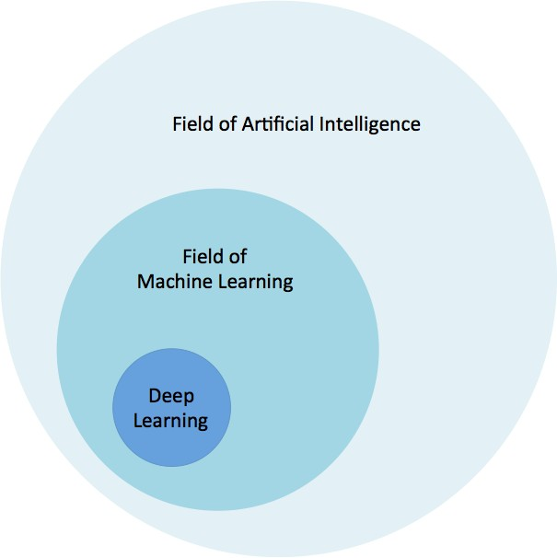
Data mining key features

Slide 20
Data mining key features
A computer program is said to learn from experience E with respect to some class of tasks T and performance measure P, if its performance at tasks in T, as measured by P, improves with experience E.
(T. Mitchell)

Slide 21
Data mining key approaches
There are two types of learning:
Precedent training
Deductive training

Slide 22
Data mining key features
The purpose of precedent training is to generalize or gain knowledge about the "law of nature."

Slide 23
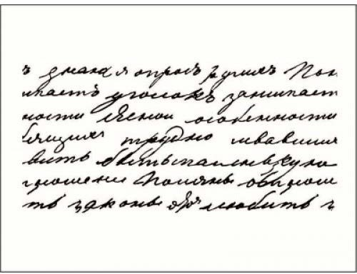
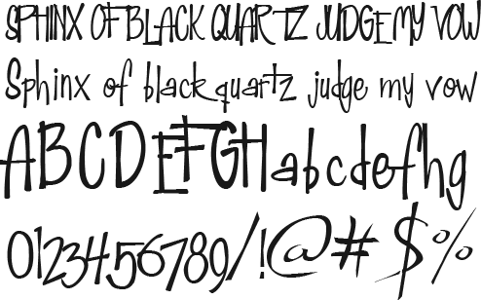
Data mining key features

Slide 24







Data mining key features
Training set
Feature extracion
Model
Prediction of objects (Trianing from objects)
New objects
Feature extraction
Trained model

Slide 25
ML task definition
Machine learning:
What is an object X (what features) and what is an answer Y?
How to build a model M?
How can we make an approximation of Y from X with M?

Slide 26
ML task definition
Input data types:
Image
Text
Sound
GEO data
Timeseries
Datasheet

Slide 27
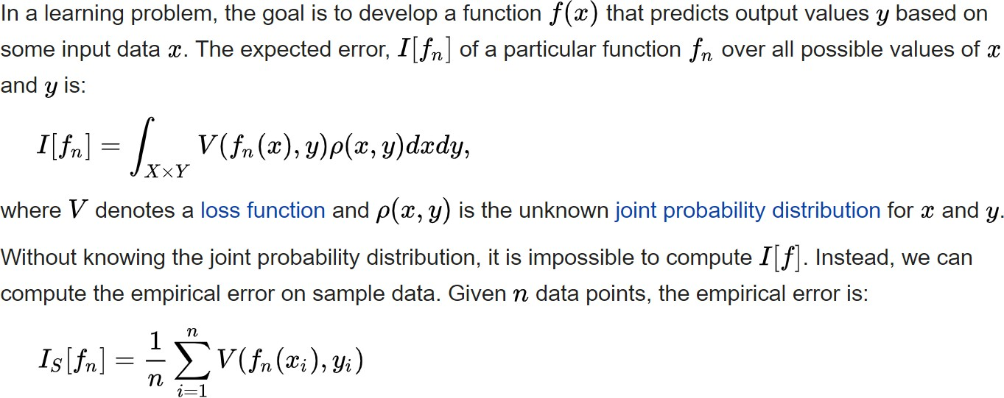
Generalization
Generalization error (also known as the out-of-sample error⁾ is a measure of how accurately an algorithm is able to predict outcome values for previously unseen data

Slide 28
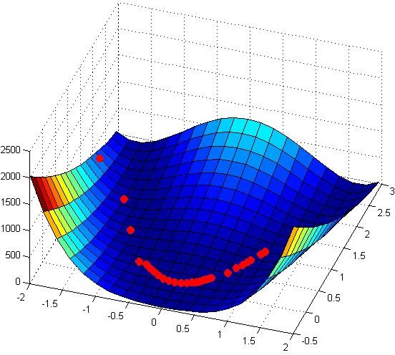
Gradient descent

Slide 29
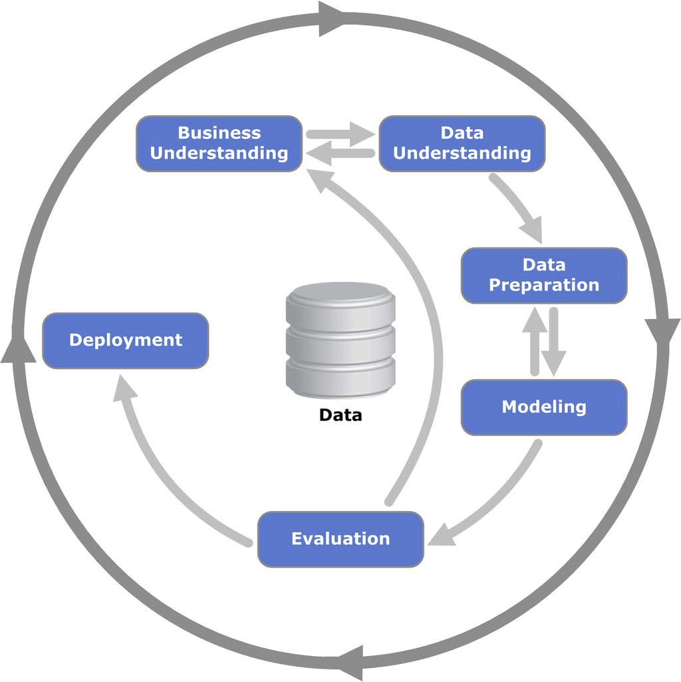
CRISP-DM methodology

Slide 30
Appliances of ML
Automation control
Bioinformatics
Stock technical analysis
Image generation
Speech generation
Text generation
Categorizing documents
Credit scoring
Medical diagnosis
Detection of fraud
Spam detection
Learning ranking in
information search
Searching potential customers
Predicting customer care
Decision-making
Predicting time series
Gesture recognition
Image recognition
Speech recognition
Рecognition of handwriting
Recognition of physical activity
Technical diagnostics
Financial supervision
Chemoinformatics

Slide 31
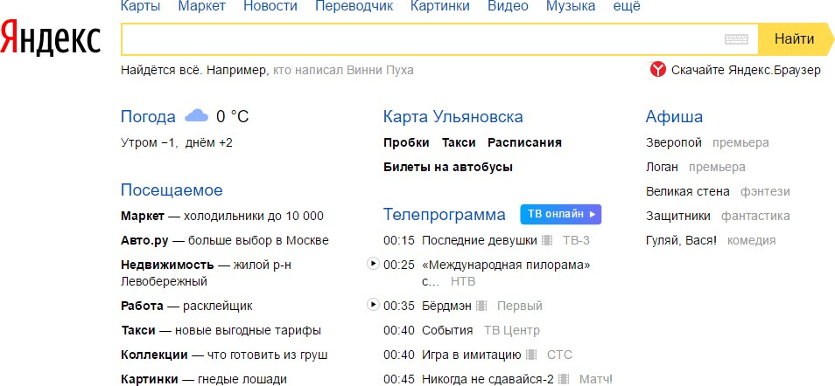

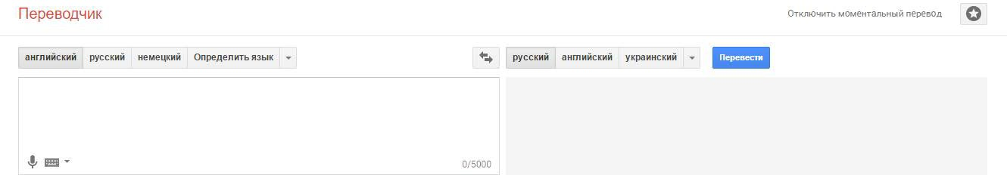
ML application

Slide 32
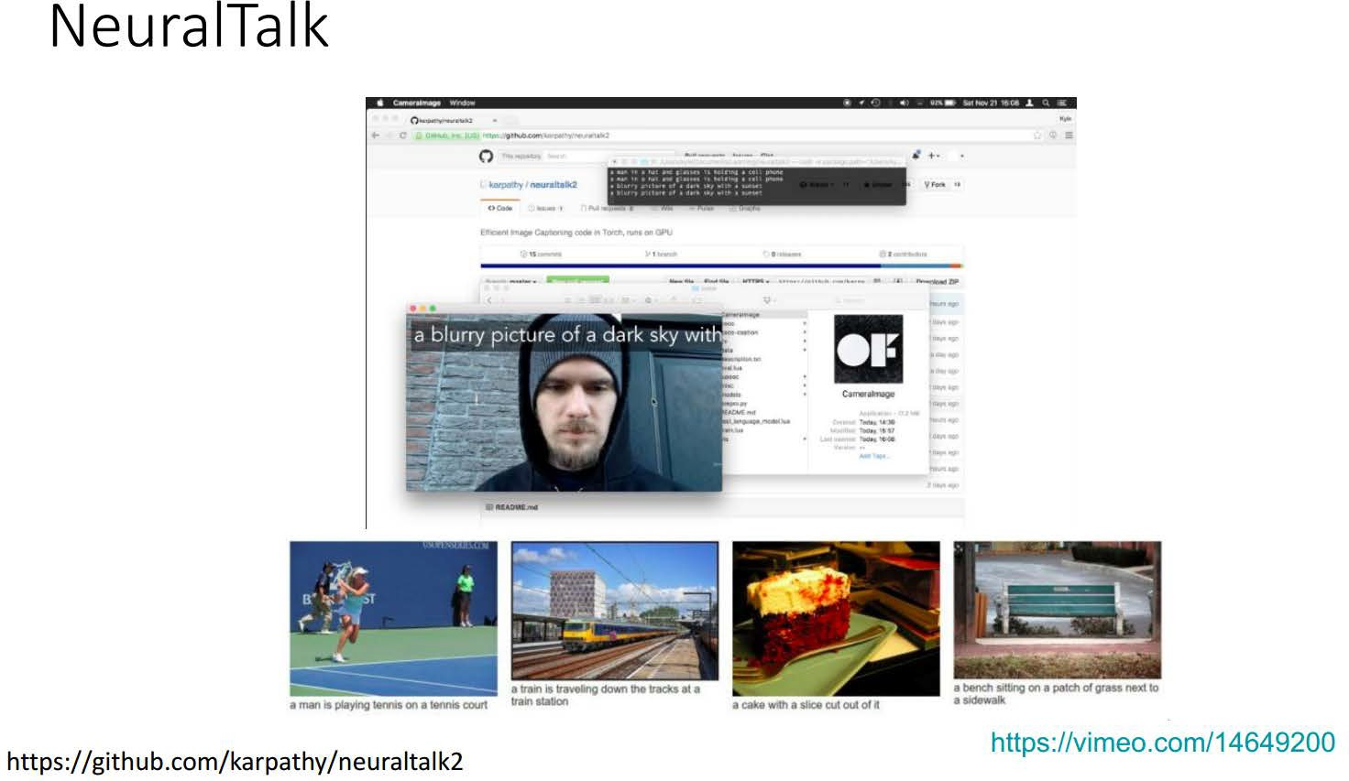
ML application

Slide 33
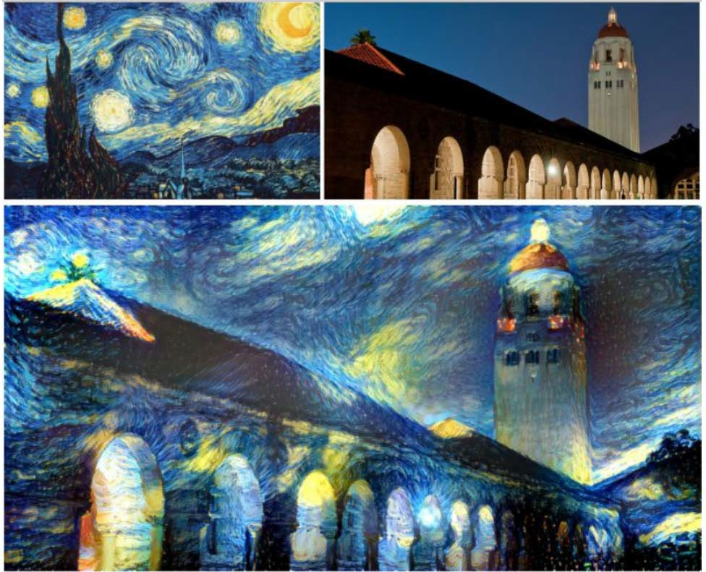
ML application

Slide 34
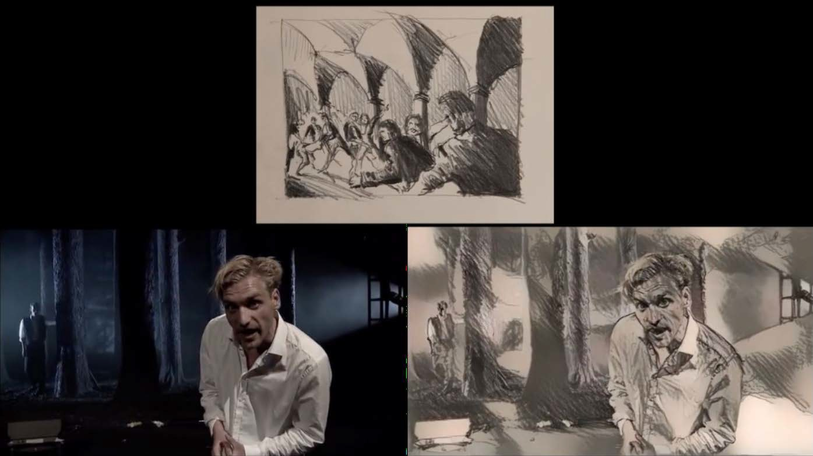
ML application

Slide 35
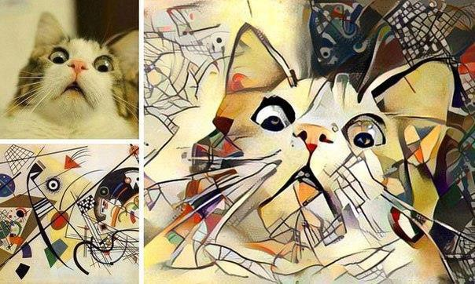
ML application. Generative models

Slide 36
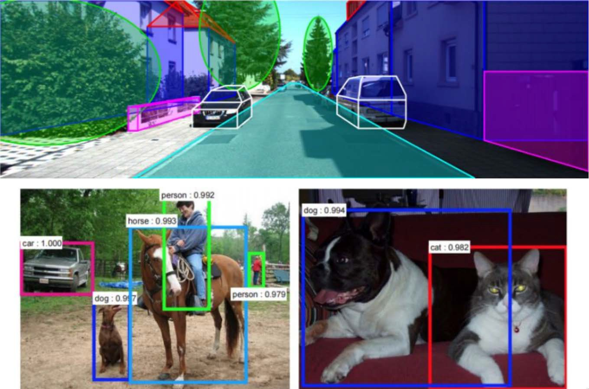
ML application

Slide 37
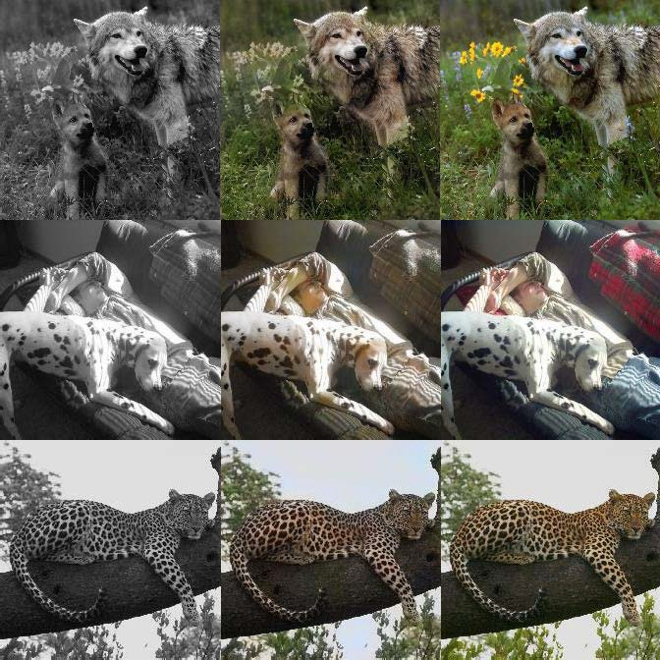
ML application. Colorization

Slide 38
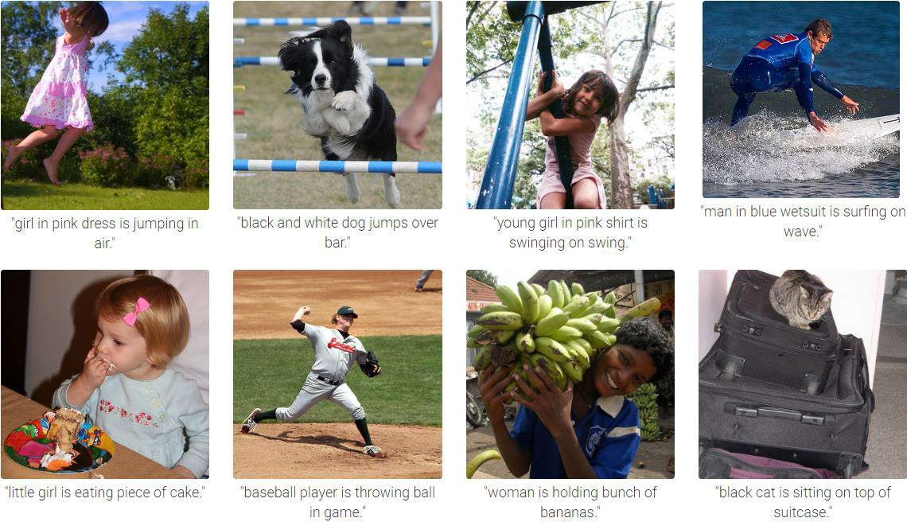
ML applications. Labeling

Slide 39

Transport systems
Route planning
Logistic control
Robotization

Slide 40

Energy
Planning and management of production and distribution of energy
Consumption management

Slide 41

Medical care
Automation of primary diagnostics
Decision making for diagnoses, treatment and follow-up
Medical data mining
Medical robots
Epidemic forecast
Genetic analysis

Slide 42
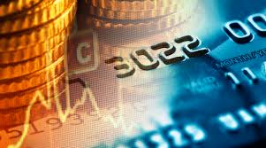
Financial services
Forecasting
Antifraud
Credit scoring
Management of risks
Professional bank assistants

Slide 43

E-commerce
Demand forecasting
Demand management and recommendation systems
Logistics

Slide 44
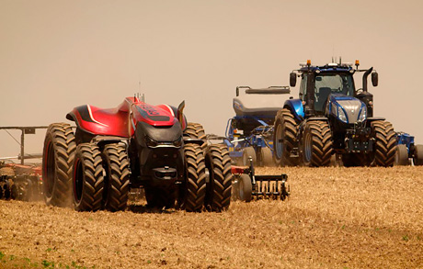
Agriculture
Monitoring (global)
Farming
Robotization of agricultural equipment
Analysis and planning of consumption and production of products, equipment

Slide 45

National security
Intelligent analysis and risk prediction
Anti-terrorism

Slide 46

Education
Individualization of the training process
Online training
Forecasting needs
Assistants

Slide 47
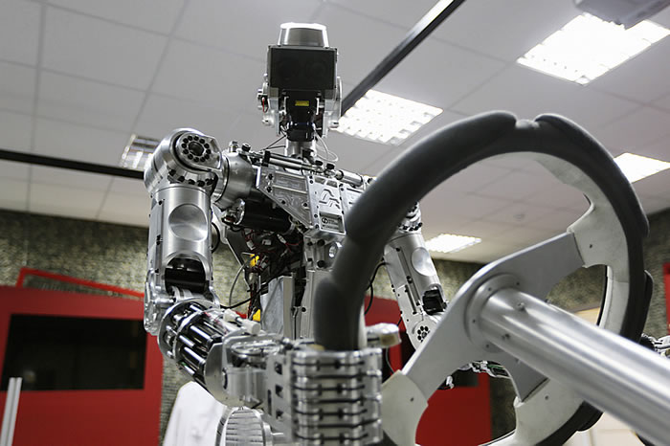
Defence
Planning
Decision making
Robots and coalitions

Slide 48
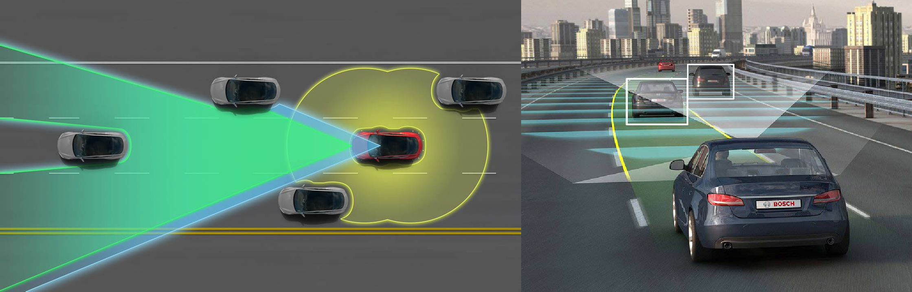
ML application

Slide 49
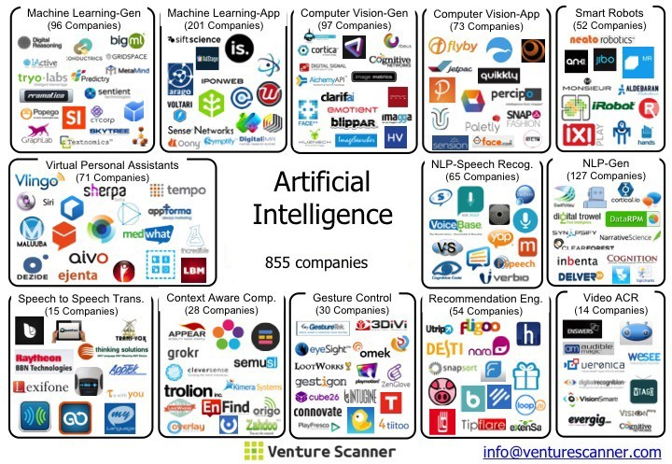
ML application

Slide 50
ML tasks types
Supervised learning:
Classification
Regression
Learning to rank
forecasting
Uunsupervised learning:
Clustering
Association rules learning
Outliers detection
Reinforcement learning
Meta-learning or learning-to-learn
Portfolio selection
Collaborative filtering 7. …

Slide 51
Approaches and methods
Regression
Bayesian inference
Decision trees
Neural networks
K-nearest neighbors
Principal component analysis
Support vector machines
Genetic algorythms

Slide 52
Tools
Python, R, Matlab, …
IPython Notebook, PyCharm
Tensor Flow, Keras, Theano, Scikit-Learn
CNTK
Torch
Caffe
Apach Spark
Azure

Slide 53
Automation
Automation controls the processes, but the person is responsible for processes.
G. Kasparov: “I played strange chess, not the kind to which I am used to, I tried to use our human advantages over the machine. But if I loose a trump card, I am doomed."
Dangerous Conflict: Operators may rely on automation tools and, when faced with an unexpected problem, try to ignore it, rather than turn the automation off and switch to manual control. On the other hand, people can mistake the definition of a dangerous or threatening situation, mistaking it for safe.
A new type of failure appears, associated not with equipment breakdowns, but with inadequate operation of automation in the diagnosis of on-board systems.
A.Kostin, 2001. https://old.computerra.ru/197252/

Slide 54
Principles of Human-Computer Interaction
P. Fitts: the principle of advantageous opportunities: functions of a person and automation tools should be assigned depending on whose advantages will be better used in the performance of the control task
N.Jordan. Allocation of functions between man and machines in automated systems. Journal of Applied Psychology, 47 (3) (1963): it is not necessary to distribute functions, but to organize the joint activity of man and machine in such a way as to mutually reinforce their functions. Complementarity can be expressed both in ensuring the optimal difficulty of the activity, and in redundancy, duplication of a machine by a person in the event of failures in its operation by switching to a manual control mode.
N. D. Zavalova, B. F. Lomov and V. A. Ponomarenko. The principle of mutual redundancy of the operator and automation tools: semi-automatic control modes should be the main mode and should be selected based on the assessment of the adequacy of the use of quantitative criteria in automation programs, and automatic and manual ones should be considered as backup mode for insurance of the operator and automation

Slide 55
Links
[ML course by Andrew Ng](https://www.coursera.org/learn/machine- learning)
[ML course by Dmitry Efimov](https://github.com/diefimov/MTH594_MachineLearning)
[ML course by OpenData Science](https://github.com/Yorko/mlcourse.ai)
[MIT Deep learning](https://github.com/lexfridman/mit-deep-learning)
https://github.com/qati/DeepLearningCourse
https://github.com/roebius/deeplearning_keras2
https://github.com/enggen/Deep-Learning-Coursera
https://github.com/fchollet/deep-learning-with-python-notebooks

